Slide 1
Automated Demand Forecasting :
Xpert Modeller
www.applexus.com

Slide 2
Demand Forecasting
Objective : Forecast product demand for a defined time horizon, given a time series of historical order / sales data
Demand forecasting is important in supply chain planning to minimize inventory costs and for price optimization

Slide 3
Statistical Methods for Demand Forecasting
Following 12 statistical models are supported
Averaging (Simple, Weighted)
Moving (Simple, Weighted)
Exponential Smoothing (Single, Double, Triple)
Adaptive Response Rate Exponential Smoothing
ARIMA Modelling (AR, MA, ARMA, ARIMAX)

Slide 4
Module-1 : Xpert Modeller
Demand forecasting is traditionally carried out using statistical time series modelling
Building statistical models require in depth knowledge and understanding of statistical methods and processes
Given a time series of historical order / sales data, Xpert modeller automatically forecasts the order demand for a defined time horizon

Slide 5
Xpert Modeller
Xpert Modeller uses ARIMA modeling for automated forecasting
ARIMA is very popular method and widely accepted in industry
ARIMA can handle any time series with/without seasonality

Slide 6
ARIMA (p,d,q) modeling
Autoregressive AR process
Series current values depend on its own previous values
AR(p) - Current values depend on its own p-previous values
p is the order of AR process
Moving average MA process:
The current deviation from mean depends on previous deviations
MA(q) - The current deviation from mean depends on q- previous deviations
q is the order of MA process
Integrated I process:
Extract trends by subtracting with lagged series
d is the order of I process

Slide 7
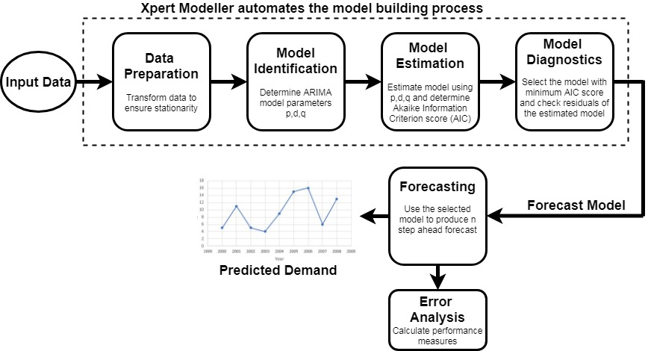
Xpert Modeller - Block Diagram

Slide 8
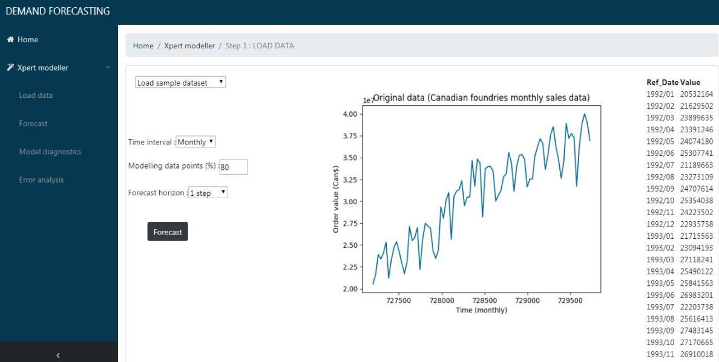
Xpert Modeller – User Interface
http://forecast.aplx.us

Slide 9
Machine Learning Modeller
Demand forecasting can be done using Machine learning models
Given a dataset with features which influences the sales
Features includes date, product category, location, promotion, weather, holiday, sentiment, fuel price, etc.
Modeller fits a model using the trained features and predicts demand using the model.

Slide 10
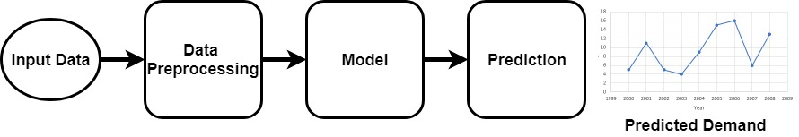
Machine Learning Modeller

Slide 11
Machine Learning Methods for Demand Prediction
Support Vector Machine
K Nearest Neighbour
Neural Network
Decision Tree
Random Forest
Gradient Boosting

Slide 12
Gradient boosted Decision tree
Gradient boosting is a machine learning technique for regression and classification problems, which produces a prediction model in the form of an ensemble of weak prediction models.
Gradient Boosting = Gradient Descent + Boosting
Fit an additive model in a forward stage-wise manner.
In each stage, introduce a weak learner to compensate the shortcomings of existing weak learners.
In Gradient Boosting, shortcomings are identified by gradient descent.

Slide 13
XGBoost
XGBoost (Extreme Gradient Boosting) is an optimized distributed gradient boosting library.
It uses gradient boosting (GBM) framework at core. Yet, does better than GBM framework alone.
XGBoost is an implementation of gradient boosted decision trees designed for speed and performance.
XGBoost = Gradient Boosting + Optimization

Slide 14
Rossmann Store Sales Dataset
The dataset provided with historical sales data for 1,115 Rossmann stores.
Store - a unique Id for each store
Sales - the turnover for any given day (this is what you are predicting)
Open - an indicator for whether the store was open: 0 = closed, 1 = open
State Holiday - indicates a state holiday. Normally all stores, with few exceptions, are closed on state holidays. Note that all schools are closed on public holidays and weekends. a = public holiday, b = Easter holiday, c = Christmas, 0 = None
School Holiday - indicates if the (Store, Date) was affected by the closure of public schools
Promo - indicates whether a store is running a promo on that day

Slide 15
Results

Slide 16
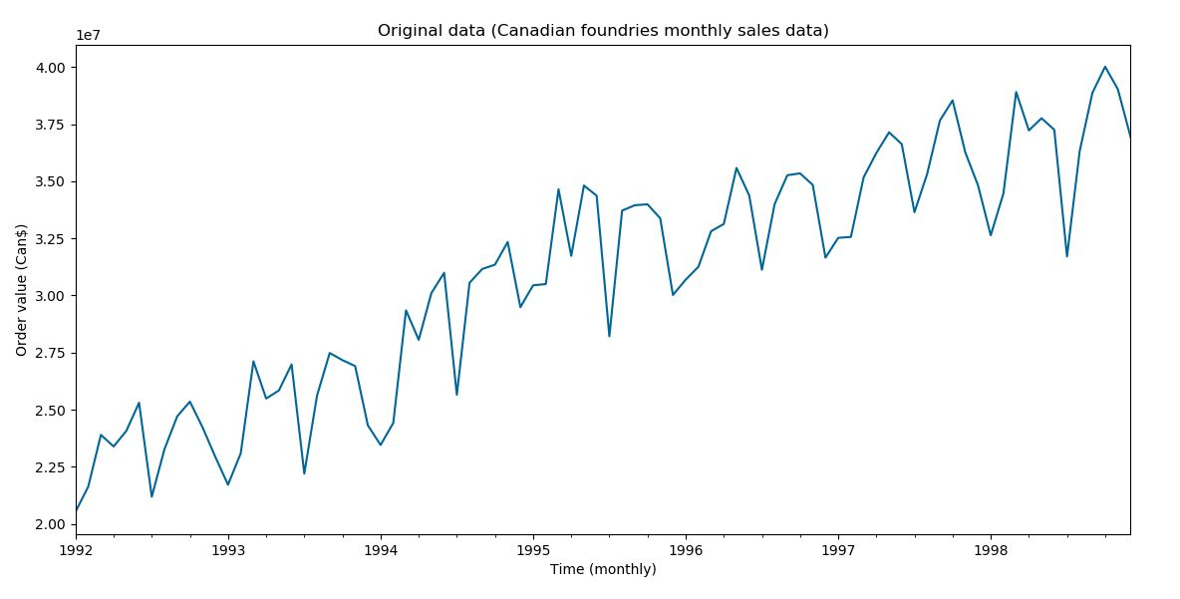
Original Data – Canadian Foundries Monthly Data

Slide 17
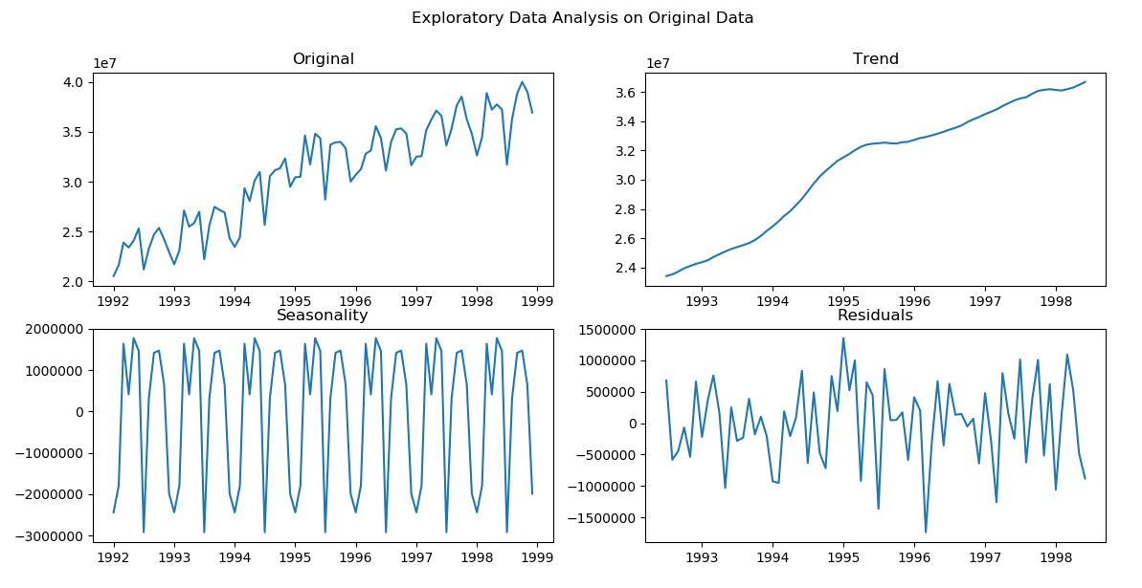
Exploratory Data Analysis

Slide 18
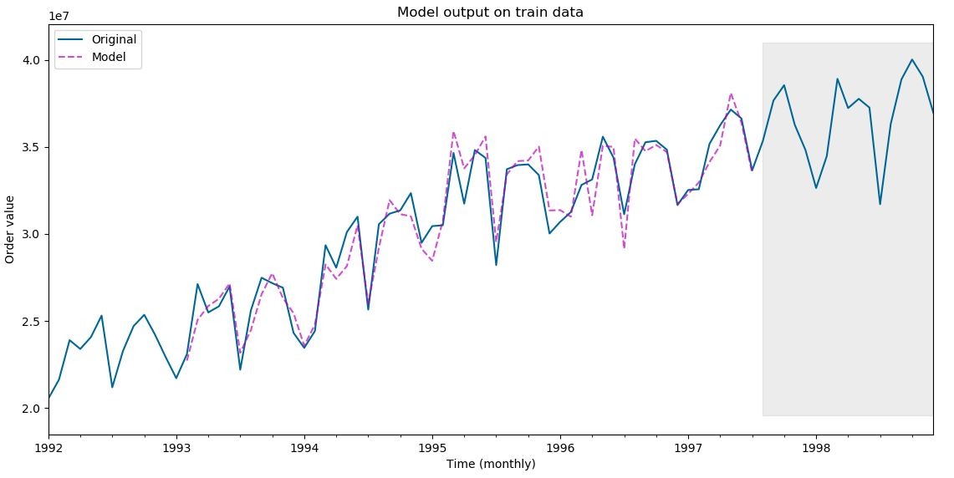
Model Output on Train Data
Train data
Validation data

Slide 19
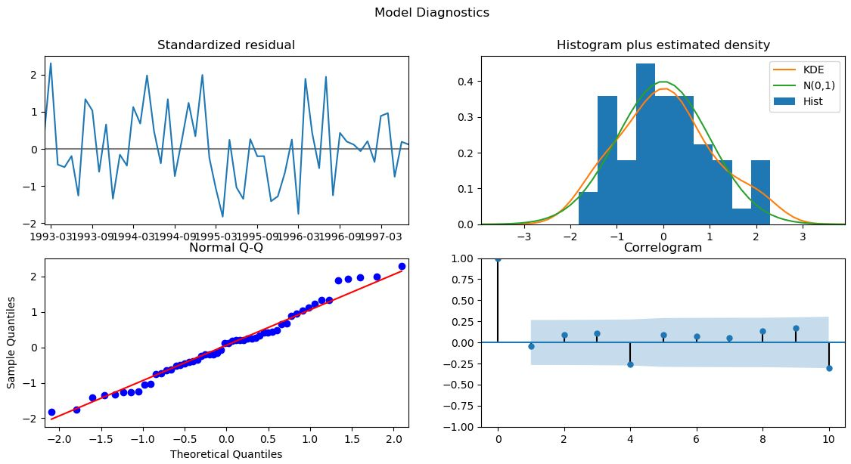
Model Diagnostics

Slide 20
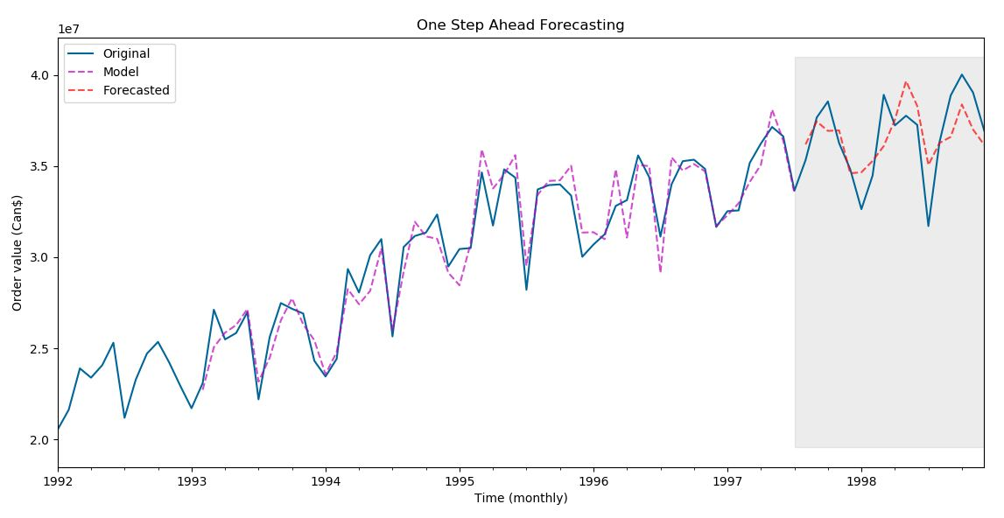
One Step Ahead Forecasting
Train data
Validation data
Train data
Validation data

Slide 21
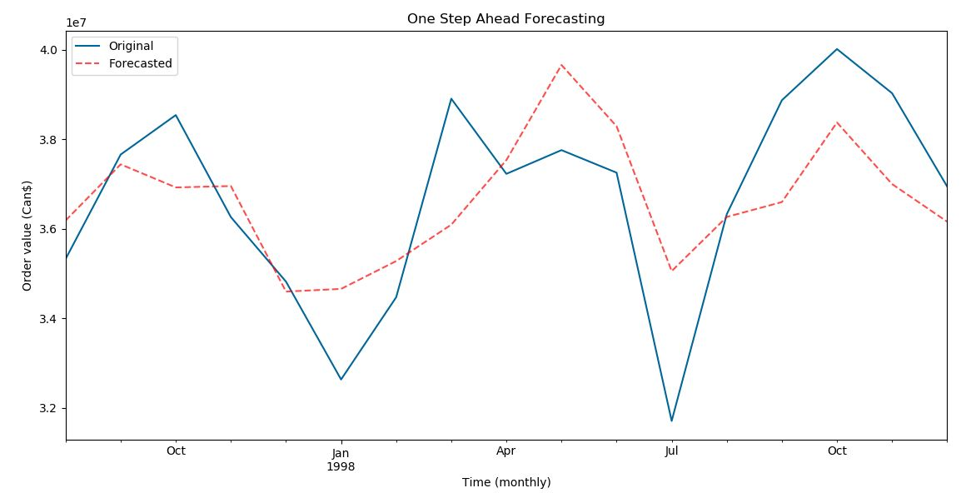
One Step Ahead Forecasting

Slide 22
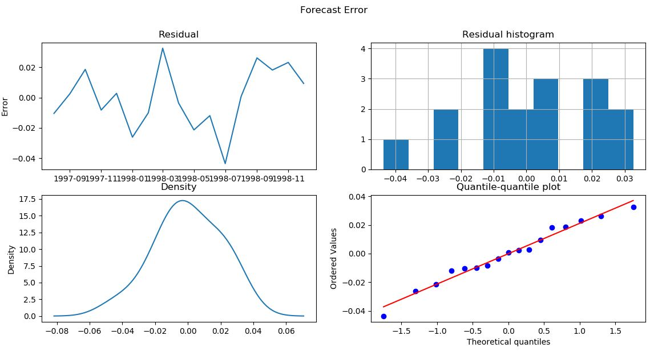
Forecast Errors

Slide 23
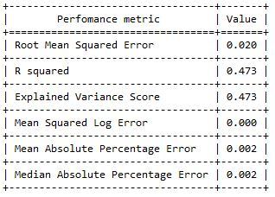
Perfomance Measures

Slide 24
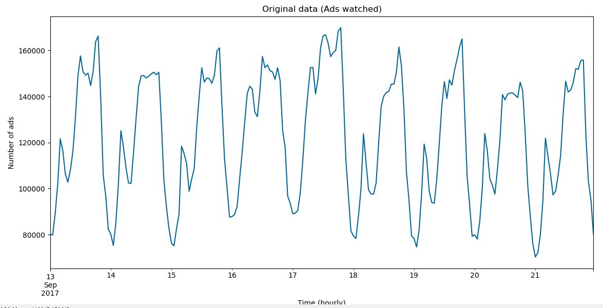
Original Data – Ads Watched Hourly Data

Slide 25
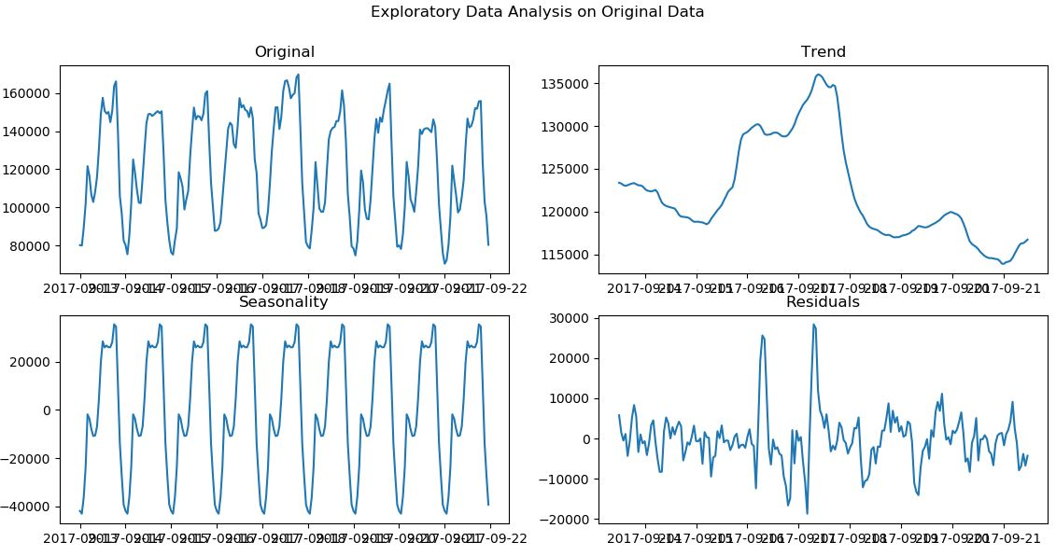
Exploratory Data Analysis

Slide 26
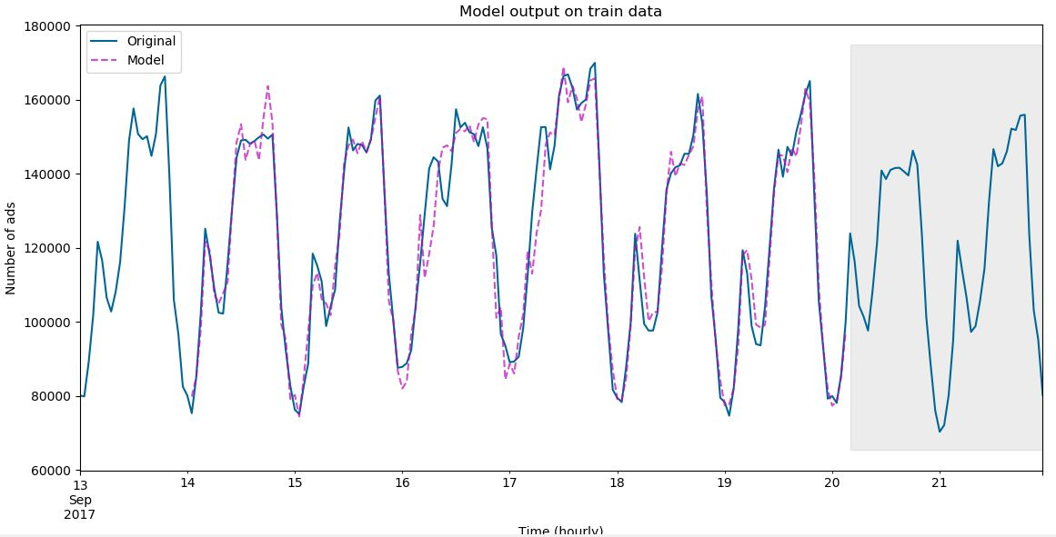
Model Output on Train Data
Train data
Validation data
Validation data

Slide 27
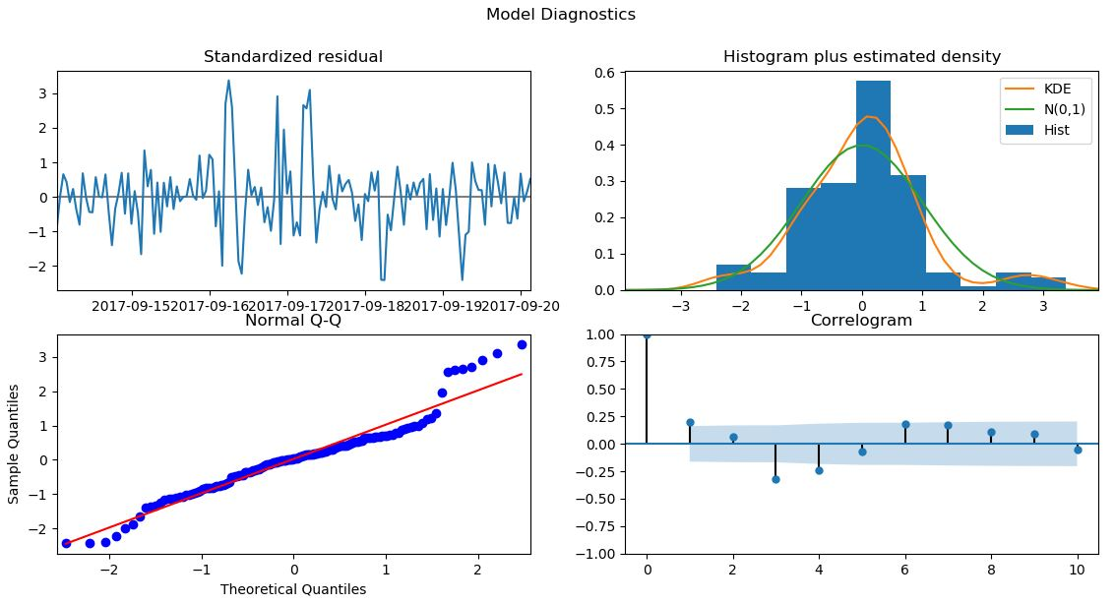
Model Diagnostics

Slide 28
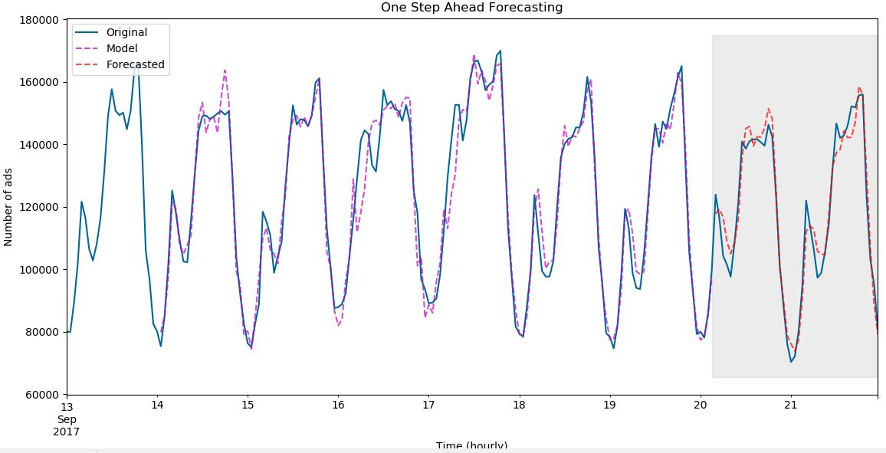
One Step Ahead Forecasting

Slide 29
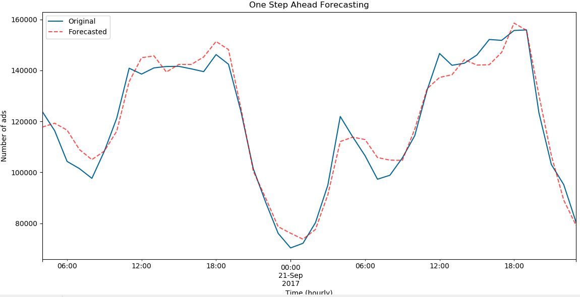
One Step Ahead Forecasting

Slide 30
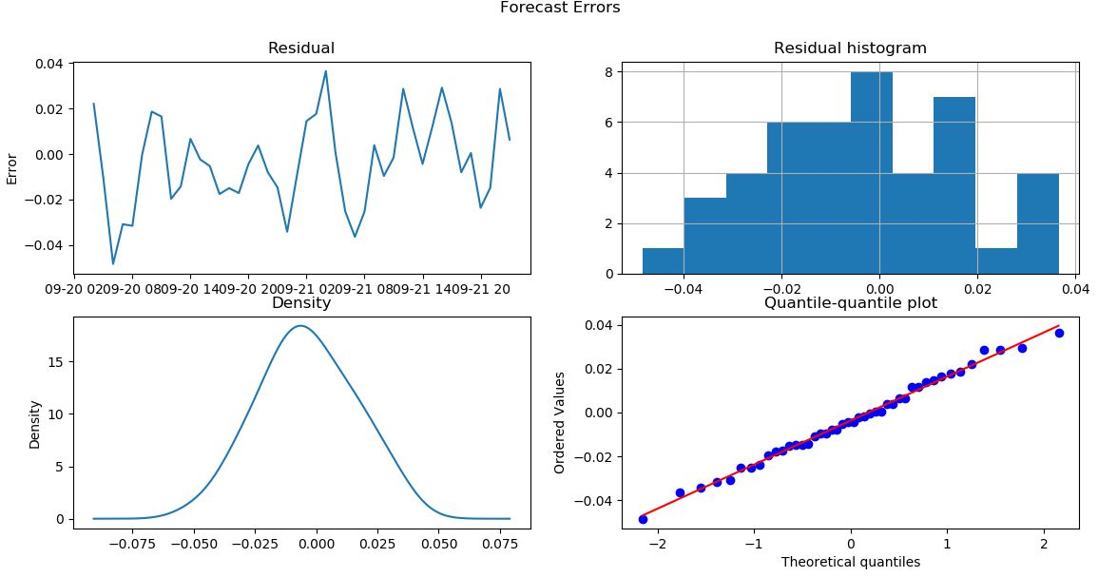
Forecast Errors

Slide 31
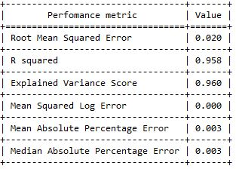
Perfomance Measures

Slide 32
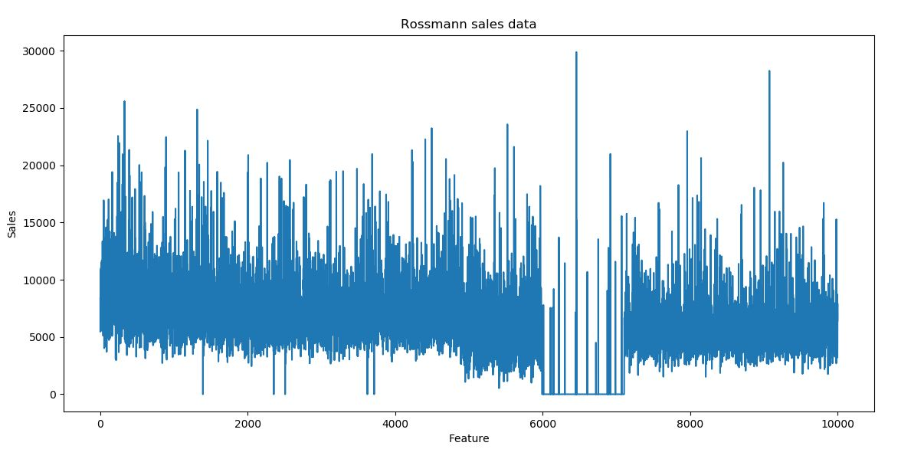
Machine Learning Modeller – Rossmann Dataset

Slide 33
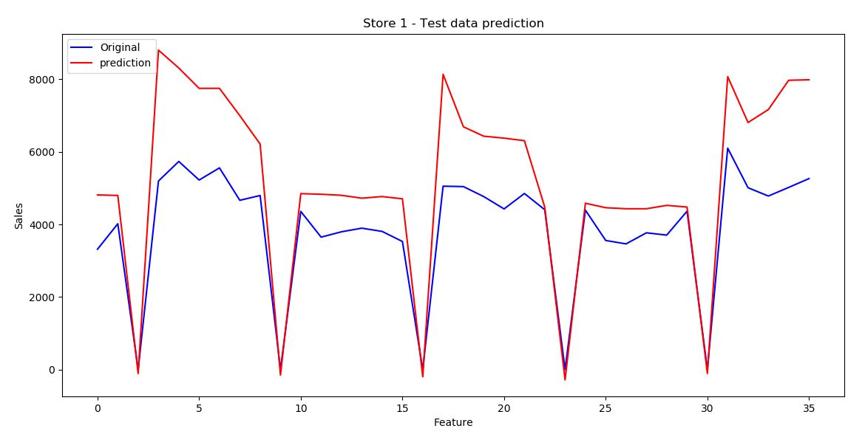
Sales prediction – Rossmann dataset

Slide 34
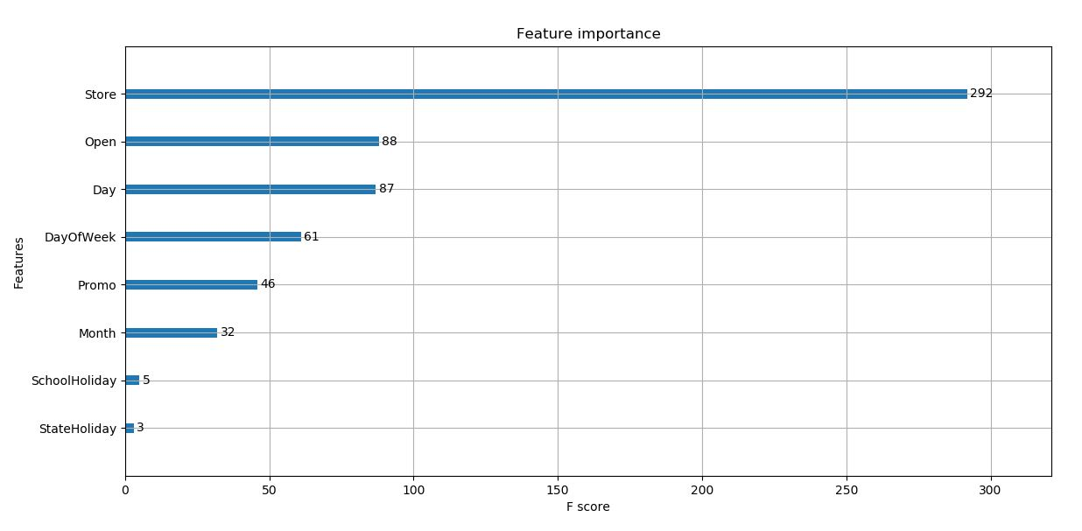
Feature Importance

Slide 35
Your Phone #
contact@applexus.com

